Slide 1
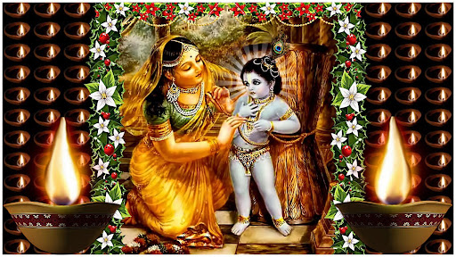
Festival of Lights

Slide 2

What are the festivals
we celebrate in this
month? (OCT 08- Nov 05)
Notes:
This is ice breaker questions 3 to 4 members u can allow them to answer the festival names celebrated this month.

Slide 3
Bahula –Ashtami (Oct 14)
(Appearance of Sri Radha kunda)
Diwali (Oct - 21)
Govardhan Pooja, Go puja (Oct - 22)
Gopashtami (Oct – 30)
Tulasi –Shaligrama Vivah (Nov - 05)
Notes:
U can read out few festivals and mention that the purpose of so many festivals in this month is so much special, than all other 11 months.
Also say unknowingly u celebrate festivals in correct way they are benefited and liberated . Explain what is correct way i.e not by watching new movie or picnic or just casual visit to temple for name sake. Correct way of celebration means hear the festival importance, decorate lord, offer the cooking to lord,feed the vaisnavas and chant the lords name. Then they get the benefit.

Slide 4
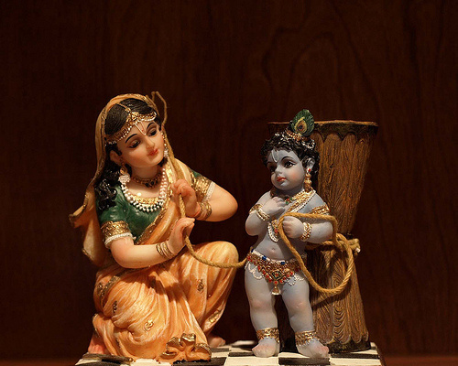
Dama means ‘rope’ and udara means ‘belly’.
Since naughty Krishna was bound by the rope by His mother Yashoda, he is called “Damodara”

Slide 5
Lets dive into the pastime…

Slide 6
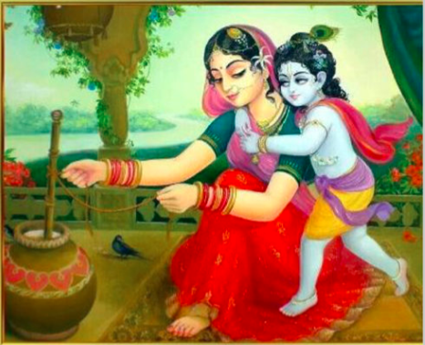
Lord Krishna desiring to drink milk, went to mother Yashoda. She fed baby Krishna her milk.
But soon, she left the child unsatisfied and went to take care of the overflowing milk in the oven.
Mother Yasoda Binds Lord Krsna
SB. Canto 10 Chapter-9
Notes:
One day when mother Yaśodā saw that all the maidservants were engaged in other household affairs, she personally began to churn the yogurt. While churning, she remembered the childish activities of Kṛṣṇa
Lord Kṛṣṇa, desiring to drink the milk of her breast, appeared before her
Mother Yaśodā then embraced Kṛṣṇa, allowed Him to sit down on her lap to feed the milk,
But when she saw that the milk pan on the oven was boiling over, she immediately left her son to take care of the overflowing milk, although the child was not yet fully satisfied with drinking the milk of His mother’s breast.

Slide 7
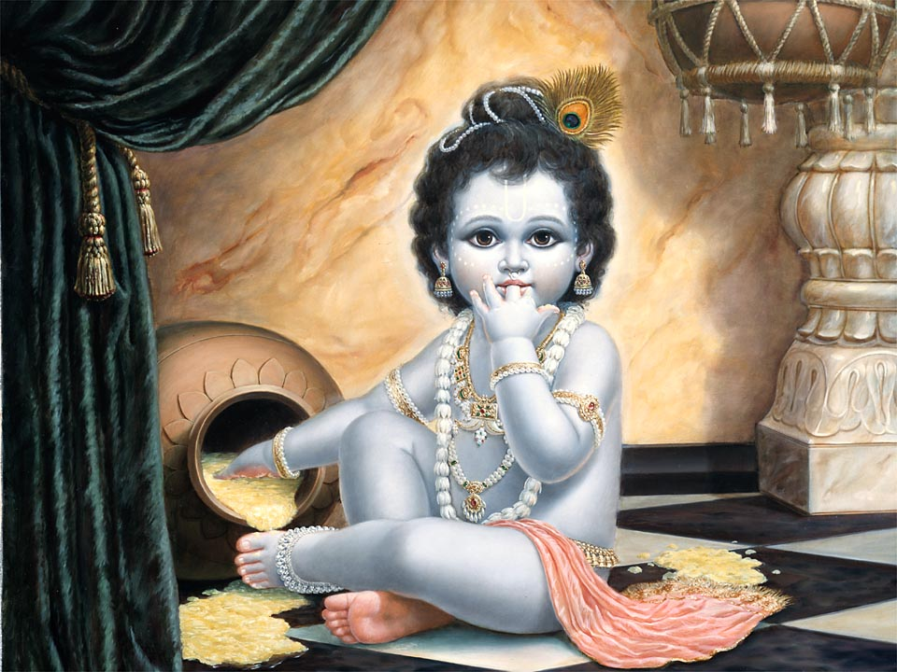
Kṛṣṇa got very angry, with false tears he broke the container of yogurt with a piece of stone and began to eat the freshly churned butter in a solitary place.
Mother Yaśodā, after taking down the hot milk from the oven, returned to the churning spot, and saw the broken pots.
Notes:
Being very angry and biting His reddish lips with His teeth, Kṛṣṇa, with false tears in His eyes, broke the container of yogurt with a piece of stone. Then He entered a room and began to eat the freshly churned butter in a solitary place.
Mother Yaśodā, after taking down the hot milk from the oven, returned to the churning spot, and when she saw that the container of yogurt was broken and that Kṛṣṇa was not present, she concluded that the breaking of the pot was the work of Kṛṣṇa.

Slide 8
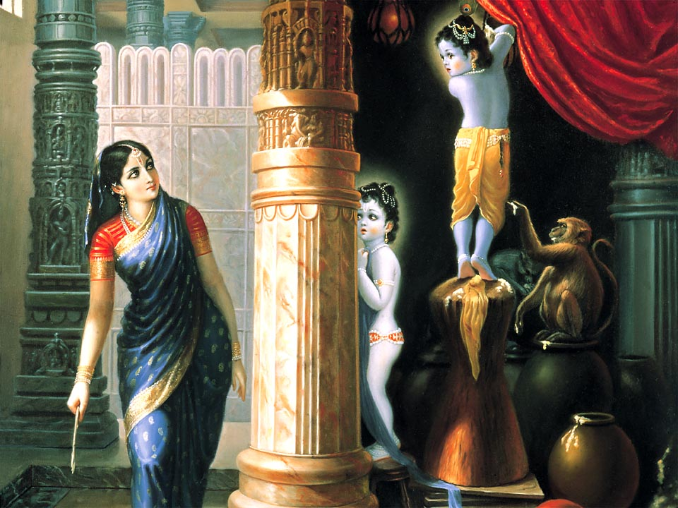
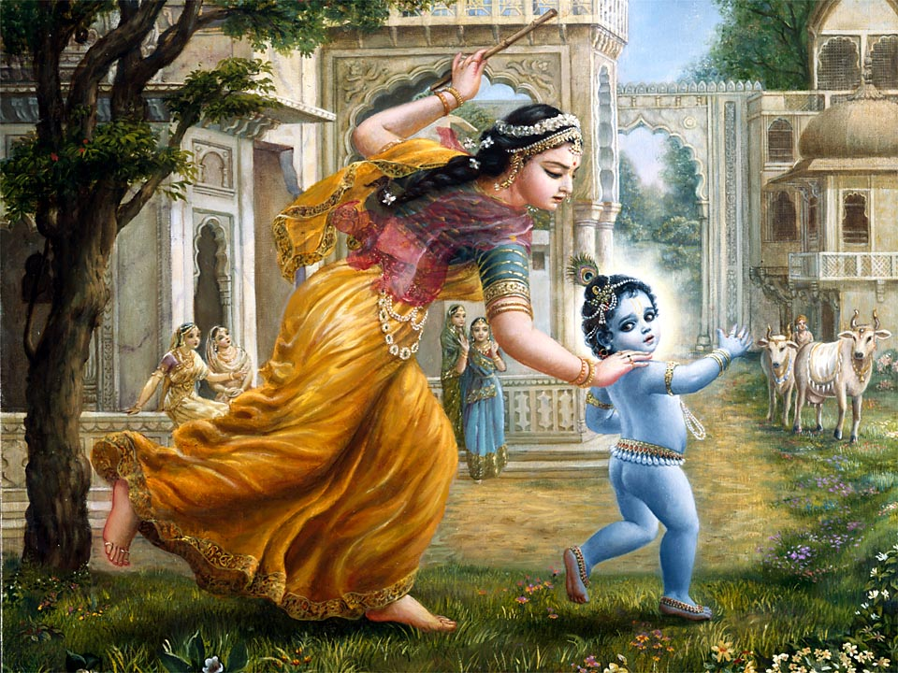
  Kṛṣṇa, stood on an upside -down wooden mortar for grinding spices and was distributing milk preparations such as yogurt and
  butter to the monkeys and friends.
  Seeing mother Yashoda with stick in hand , Kṛṣṇa started running only to be caught & chastised by her. But seeing that Kṛṣṇa was afraid, she desired to bind the Lord as punishment.
Notes:
Kṛṣṇa, at that time, was sitting on an upside-down wooden mortar for grinding spices and was distributing milk preparations such as yogurt and butter to the monkeys as He liked. Because of having stolen, He was looking all around with great anxiety, suspecting that He might be chastised by His mother.
Mother Yaśodā, upon seeing Him, very cautiously approached Him from behind.
When Lord Śrī Kṛṣṇa saw His mother, stick in hand, He very quickly got down from the top of the mortar and began to flee as if very much afraid.
When caught by mother Yaśodā, Kṛṣṇa became more and more afraid and admitted to being an offender. As she looked upon Him, she saw that He was crying, His tears mixing with the black ointment around His eyes, and as He rubbed His eyes with His hands, He smeared the ointment all over His face.
Mother Yaśodā, catching her beautiful son by the hand, mildly began to chastise Him.
When she saw that her son had become excessively afraid, she threw the stick away and desired to bind Him so that He would not commit any further naughty activities.

Slide 9
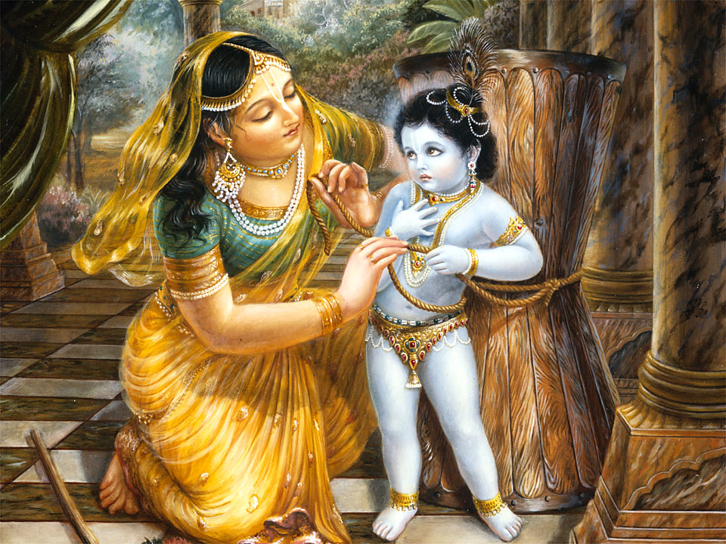
  When Mother Yaśodā was trying to bind the Little Krishna to the wooden mortar.
  She saw that the binding rope was short by the width of two fingers.
  She tried again and again with all the ropes available, but still couldn’t.
Mother Yasoda Binds Lord Krsna , SB. Canto 10 Chapter-9
  When child Kṛṣṇa saw His mother was tired, He became merciful to her and agreed to be bound. 2 inches represents our endeavor and Lord’s mercy.
Notes:
When mother Yaśodā was trying to bind the offending child to the wooden mortar , she saw that the binding rope was short by a distance the width of two fingers. Thus she brought another rope to join to it.
This new rope also was short by a measurement of two fingers, and when another rope was joined to it, it was still two fingers too short. As many ropes as she joined, all of them failed; their shortness could not be overcome.
Because of mother Yaśodā’s hard labor, her whole body became covered with perspiration, and the flowers and comb were falling from her hair. When child Kṛṣṇa saw His mother thus fatigued, He became merciful to her and agreed to be bound.
Acharyas say that this 2 inches short represent first 1 st inch is Yashoda's endeavor and 2 nd inch is lords mercy. So for any mercy our sincere endeavor showers with lords mercy.

Slide 10
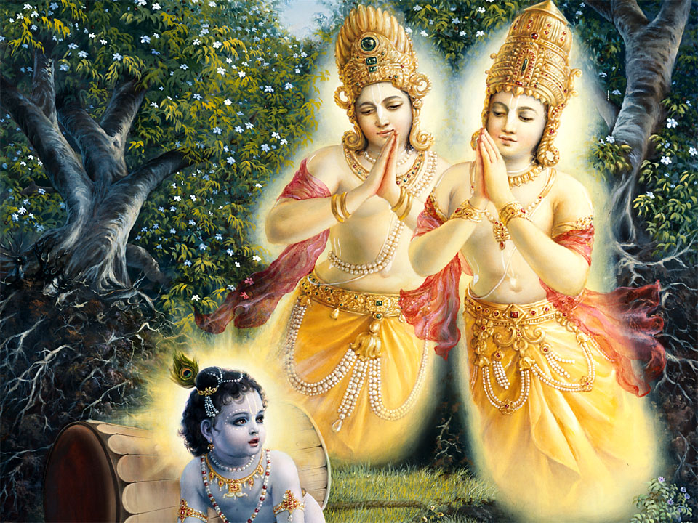
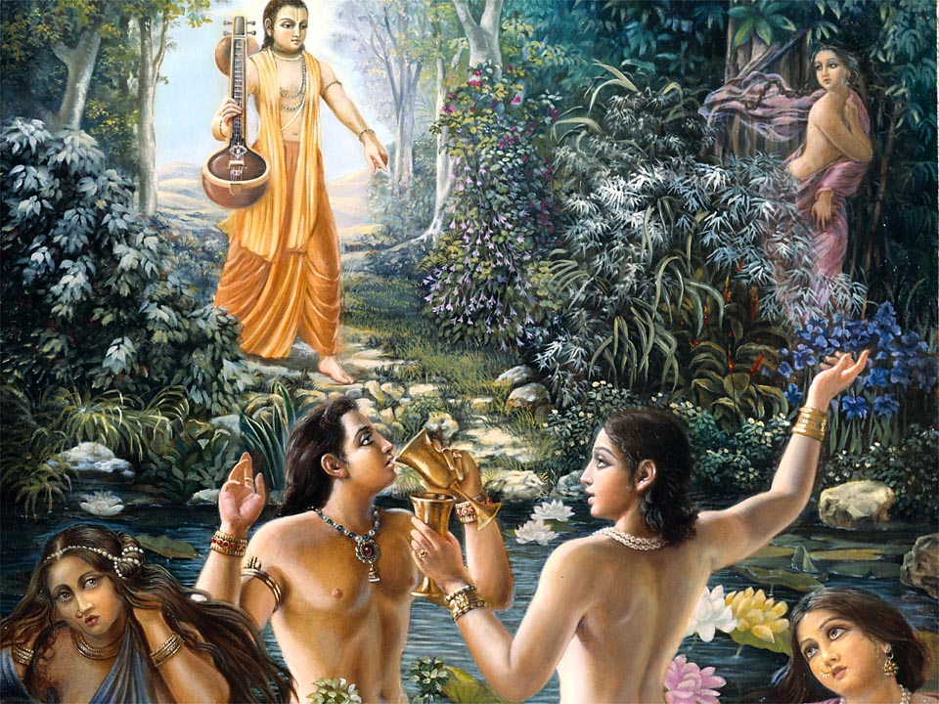
  The Supreme Lord, Kṛṣṇa, in this pastime wanted to deliver the twin trees known as yamala-arjuna, who were the sons of Demigod Kuvera, cursed by his dearest devotee Narada muni in the former millennium .
The Deliverance of the Yamala - Arjuna Trees - SB. Canto 10 Ch-10
  Nalakūvara and Maṇigrīva, were extremely opulent and fortunate. But due to pride and false prestige, they mocked at Narad muni while playing naked in the pond, and thus Nārada Muni cursed them to become trees.
Notes:
While mother Yaśodā was very busy with household affairs, the Supreme Lord, Kṛṣṇa, observed twin trees known as yamala-arjuna, he moved the mortor between this trees and fpuuled it down. In their former birth, these two sons of kuvera, known as Nalakūvara and Maṇigrīva, were extremely opulent and fortunate. But because of pride and false prestige, they did not care about anyone, and thus Nārada Muni cursed them to become trees.
Because of false prestige and madness after drinking liquor, these sons were so fallen that they are naked but cannot understand that they are.
Therefore, because they are living like trees (for trees are naked but are not conscious), these two young men received the bodies of trees.
But by mercy of Narada muni they remembered their past sinful activities and after the expiry of one hundred years by the measurement of the demigods, they will be able to see the Supreme Personality of Godhead, Vāsudeva, face to face, and thus revive their real position as devotees.

Slide 11
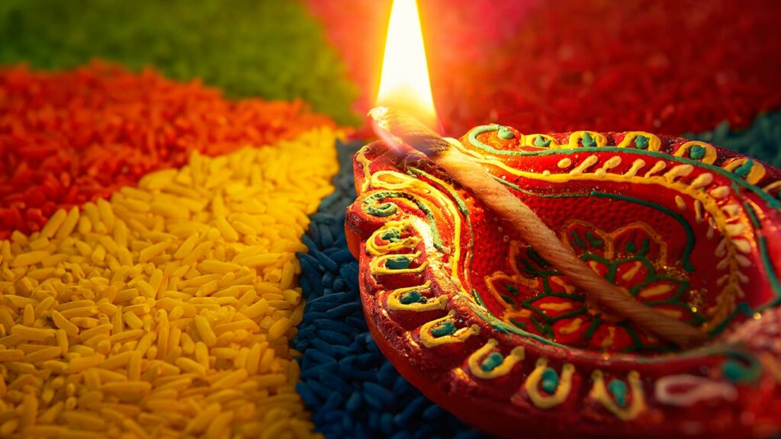
GLORIES OF DAMODARA MONTH

Slide 12
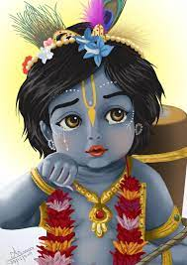
Karthik is the best, the purest of purifiers, and most glorious of all the months. Karthik month is particularly dear to Lord Sri Krishna. This month is full of bhaktha Vatsalya. Any vrata, even the smallest, will yield huge results. The effect of performing a Karthik Vrata lasts for 100 lifetimes. Whereas ordinary vrata’s only lasts for one lifetime! Srimati Radharani is the presiding deity of the holy month of Karthik. Rupa Goswami and others refer to Radharani as Karthik Devi. In other words, Radhika is the goddess of Karthik Vrata.
- Padma Purana
Quoted by Srila Sanatana Goswami in Hari-Bhakti Vilasa

Slide 13
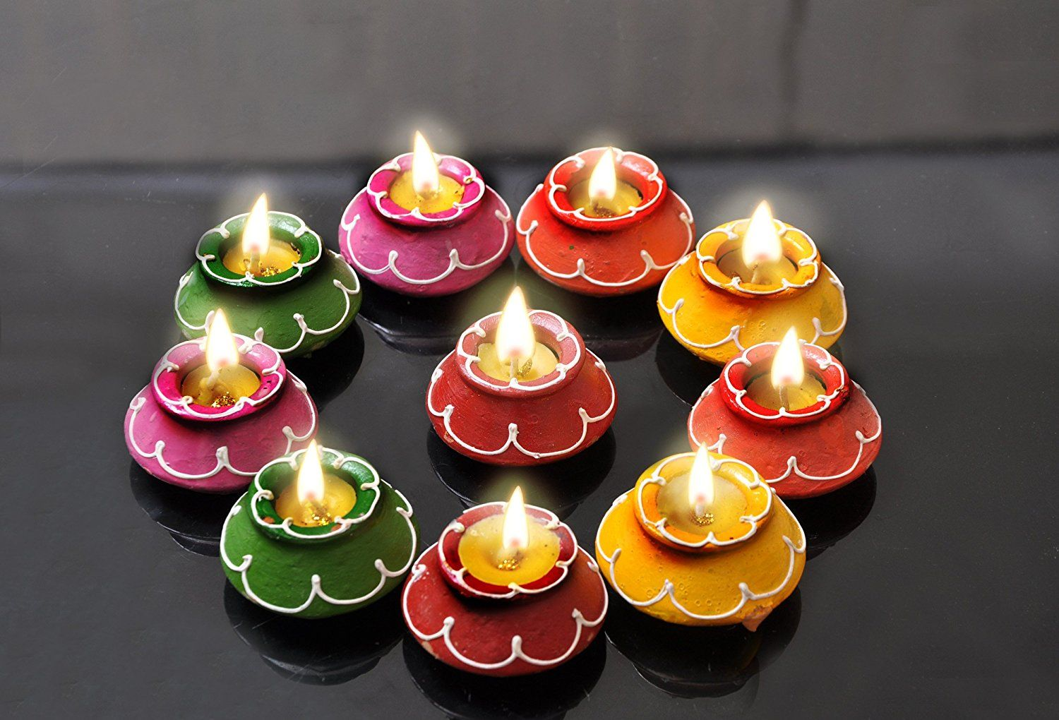

O leader of the brahmanas, one who rises from bed before sunrise during the month of Karthik and stands before Lord Dāmodara achieves the result of giving 1000
Cows in charity.
Hari bhakthi-vilasa – 16.62

Slide 14

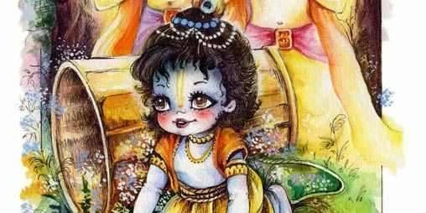
O best among the twice-born, it is stated that any pious activity, such as the giving of grains in charity, performing fire sacrifices, undergoing
Penance, or chanting mantras, that is executed during the month of Kartika, bestows unlimited benefit.
Hari bhakthi vilasa – 16.53

Slide 15


By offering a ghee lamp in the month of Kartika, the supreme personality of Godhead, Lord Hari, is pleased. Even if one offers a ghee lamp through someone else, the Lord awards him a very auspicious destination.
Hari bhakthi vilasa – 16.64

Slide 16

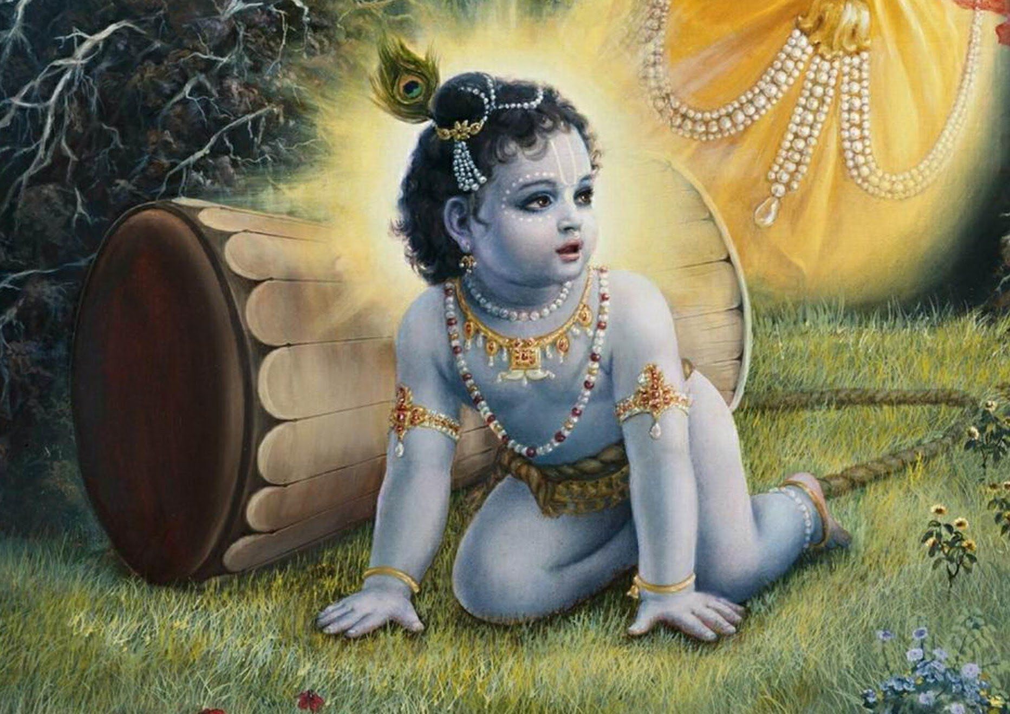
Just as Lord Dāmodara is known to be very affectionate to his devotees, His favorite month, Dāmodara, is also very magnanimous because even a small service rendered that month is accepted as very great.
Hari Bhakti Vilasa – 16.42

Slide 17
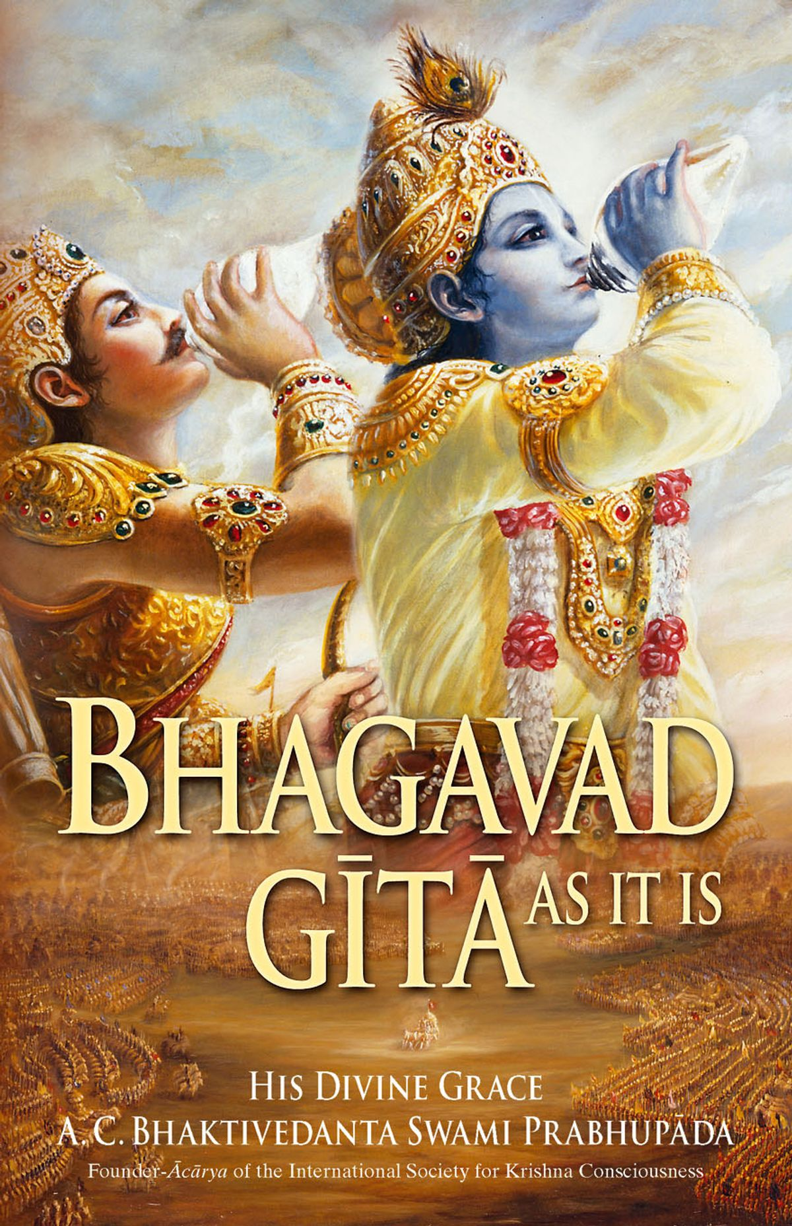

O Narada, one who discusses the Bhagavad-Gita during the entire month of karthika will never again return to this material world.
Hari bhakti Vilasa – 16.68

Slide 18
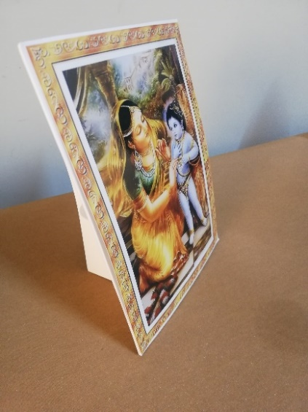
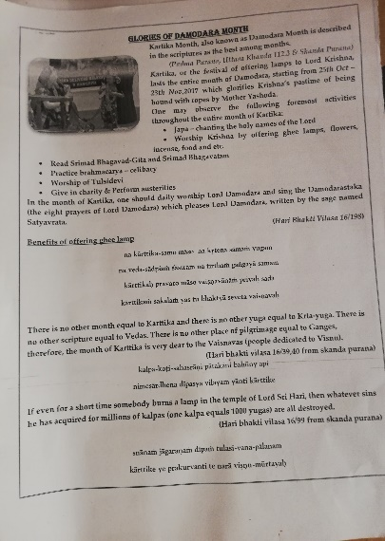
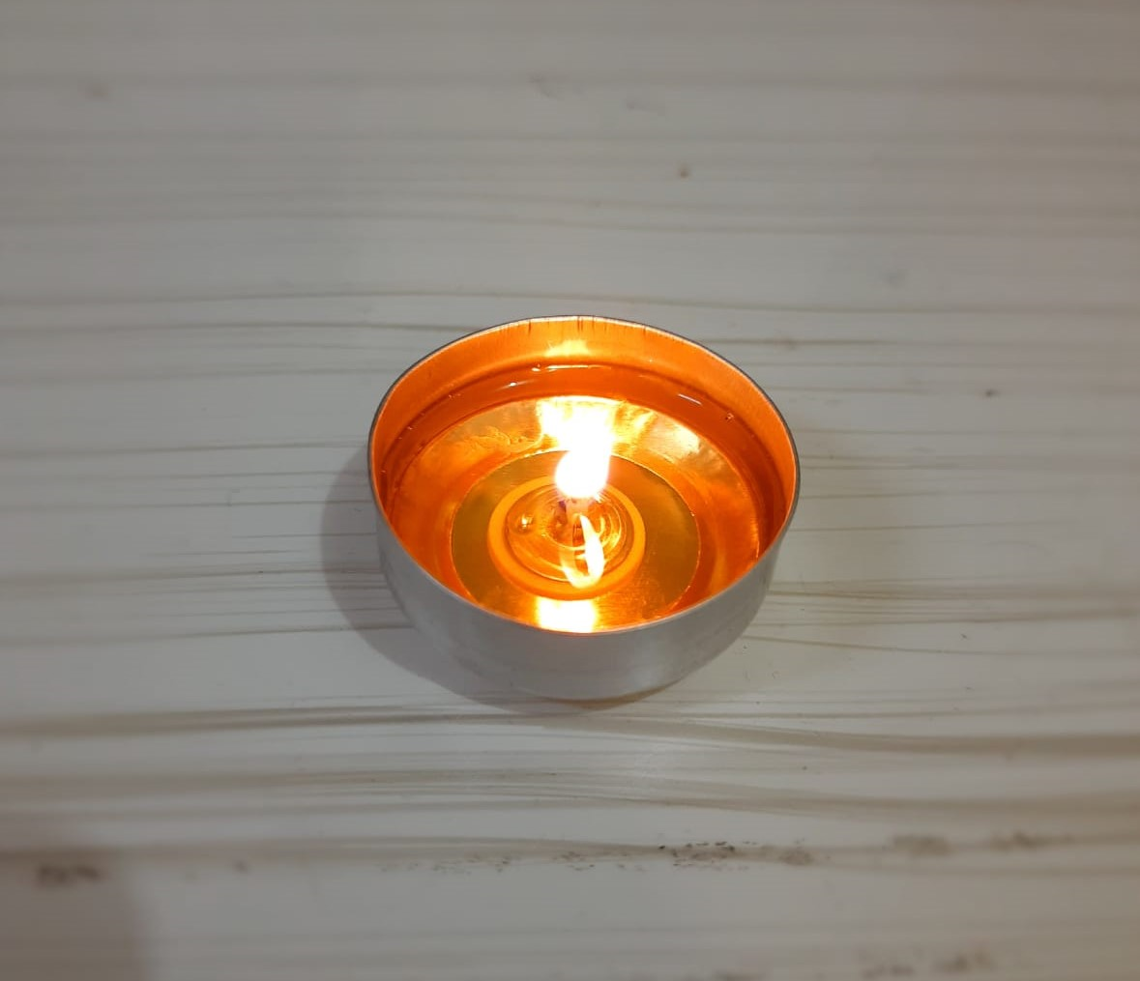
What will the kit contain?

Slide 19


Slide 20
Wish You all happy Damodara
Thankyou .

